Slide 1
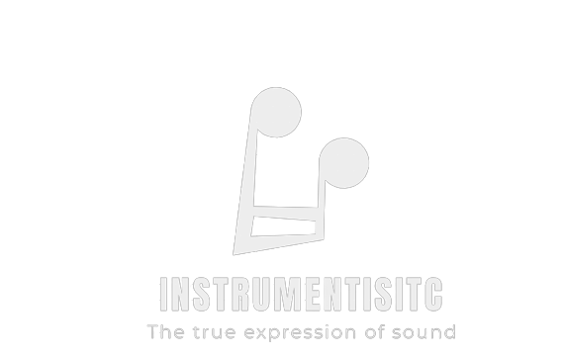
Sitemap

Slide 2

Home
About
Composers
Blog
Who we are
Alphabet list of composers
List of Blog Posts
Subscription List

